Slide 1
The 2nd Meeting of The Thai-Chilean/Chilean-Thai Joint Business Council August 19, 2014 Four Seasons Hotel, Bangkok

Slide 2
Welcome Remarks
H.E. Mr. Javier Becker, Ambassador of Chile in Thailand
H.E. Mr. Surapon Petchvra, Ambassador of Thailand in Chile
Opening Remarks
Mr. Kanit Si, Chairman of Thai-Chilean Business Council
Mr. Juan Mackenna, Chairman of Chilean-Thai Business Council

Slide 3
Welcome Remarks
H.E. Mr. Javier Becker,
Ambassador of Chile in Thailand

Slide 4
Welcome Remarks
H.E. Mr. Surapon Petchvra,
Ambassador of Thailand in Chile

Slide 5
Opening Remarks
Mr. Kanit Si,
Chairman of Thai-Chilean Business Council

Slide 6
Opening Remarks
Mr. Juan Mackenna,
Chairman of Chilean-Thai Business Council

Slide 7
Agenda
1) Introduction of Chilean Delegates and Thai Delegates
2) Confirmation of the Minutes of 1st Joint Business Council Meeting
3) Economic Overview of Chile and the Impact of Thailand-Chile FTA
4) Briefing on ASEAN Economic Community
5) Briefing & Discussion Session on Key Business Opportunities between Chile and Thailand
6) Update on the FTA between CHILE and THAILAND
7) Discussion on Future Action Plan on “ How to strengthen economic, trade and investment ties between Thailand and Chile”
8) Update 2nd FEALAC Business Forum

Slide 8
Agenda Item 1
Introduction of Chilean Delegation and
Thai Delegation

Slide 9
Agenda Item 1
Chilean Delegates :
1) Mr. Beatriz Barros
Inversiones Beatriz Barros Ltda.
Business : Jewelry
2) Mr. Oscar Jadue
Chemical Engineer
Member of the Board at Magotteaux and Augury Groups
Business : Products and Services for mining industry
3) Mr.Juan Mackenna
Civil Engineer
Member of the Board at Sigdo Koppers and Magotteaux Groups
Business : Engineering and construction ; Spices from Chile.
4) Mr.Roberto Pualuan
Commercial Engineer
Managing Director of South Pacific S.A.
Business : Fertilizer exporter and importer ; fruit producer

Slide 10
Agenda Item 1
5) Mr.Pedro Reus
Lawyer
International Manager at the Federation of Chilean Industry
Member of the Business Committee Chile-Japan ; Chile-Corea ;
Chile-China ; Chile-Perú ; Chile-Brasil
Business : Promote the development of business between Chilean businessmen and their counterparts in different countries.
Chilean Delegate residence in Bangkok
6) Mr. Jaime Rivera
Trade Commissioner & Coordinator of ASEAN Markets
Trade Commission of Chile in Bangkok,
Embassy of Chile

Slide 11
Agenda Item 1
Thai Delegates :
1) Mr. Boonchuay Chansatabutr
Country C.F.O.
Magotteaux Co., Ltd.
Business : Grinding media for mining and cement industry
2) Dr. Luckchai Kittipol
Chief Executive Officer
Thai Hua Rubber PCL.
Business : Manufacturer and exporter of natural rubber
3) Mr. Ramesh Narsinghpura
Chief Operating Officer (Corporate Affair)
Indorama Venture Public Company Limited
Business : Polyester chain business consists of three key verticals - Feedstock, PET and Polyester.
4) Ms. Maliwan Wanakornkul
Managing Director
Inter Focus (Thailand) Co., Ltd
Business : Bio juice, Health Products

Slide 12
Agenda Item 1
5) Ms. Nuda Teerakathiti
Marketing Division Manager
Sea Value PCL.
Business : Agro-business
6) Ms. Nina Techasith
Business Development Director
King Pac Industrial Co., Ltd.
Business : Plastic Packaging
7) Mr. Kriskorn Chindaprasert
Marketing Executive
SCG Trading Co., Ltd.
Business : International Trading
8) Mr.Thaweewat Nuntiruj
Managing Director
Thai Trafo Manufacturing Co., Ltd.
Business : Transformer production
9) Mr. Nuttawat Ittiphakorn
Executive Director
Siew Lamination Co., Ltd.
Business : Plastic Packaging
10) Mr. Natuchchapong Aunhakitteenant
Director
Southeast Packaging Industry Co., Ltd.
Business : Plastic Packaging
11) Ms. Nanthawan Methitanpongwanit
Chief Executive Officer
Book-it Co.,Ltd.
Business : Travelling agency

Slide 13
Agenda Item 1
12) Mr. Piti Wongraksanga
Managing Director
Thai Union Wire Co., Ltd.
Business : Cable Manufacturer
13) Ms. Malulee Kaemoraruangrit
Senior Vice President & Manager
Int’l Products& Marketing Strategy Dept.
Krungthai Bank PCL
Business : Financial Services
14) Mr. Disapong Pornchanoknart
Vice President
Kasikorn Bank PCL
Business : Financial Services
15) Mr. Vivat Chaijiraporn
Vice President
Bangkok Bank PCL.
Business : Financial Services
16) Mr. Worapoep Naruniranat
Up-Country Sales Section Manager
Bangkok Cable Co., Ltd.
Business : Electric wires and cables
17) Mr. Somboon Chi - Executive Director
18) Ms. Sudatip Kiatsrichart – Director
Pattaya Food Industries Limited
Business : Manufacturer of seafood products; focus in tuna products
19) Mr. Lee Hock Chye - Managing Director
Nautilus Food (Thailand) Co., Ltd.
Business : Manufacturer of seafood products; focus in tuna products
20) Mr. Udom Chariyarilaskul Senior Advisor,
Thai Frozen Foods Association

Slide 14
Agenda Item 1
21) Mr. Kosol Satithamajit
First Secretary
Department of International Affairs, Ministry of Foreign Affairs of Thailand
22) Mr.Pakpoom Teranantana
Director of International Organizations Department,
The Federation of Thai Industries
23) Mr. Sarit Charoenphao
Trade Officer, Practitioner Level
Department of Trade Negotiations, Ministry of Commerce
24) Representative from Thai Automotive Industry Association

Slide 15
Agenda Item 2
Confirmation of the minutes of the 1st JBC Meeting
at Santiago, Chile on March 28th, 2014

Slide 16
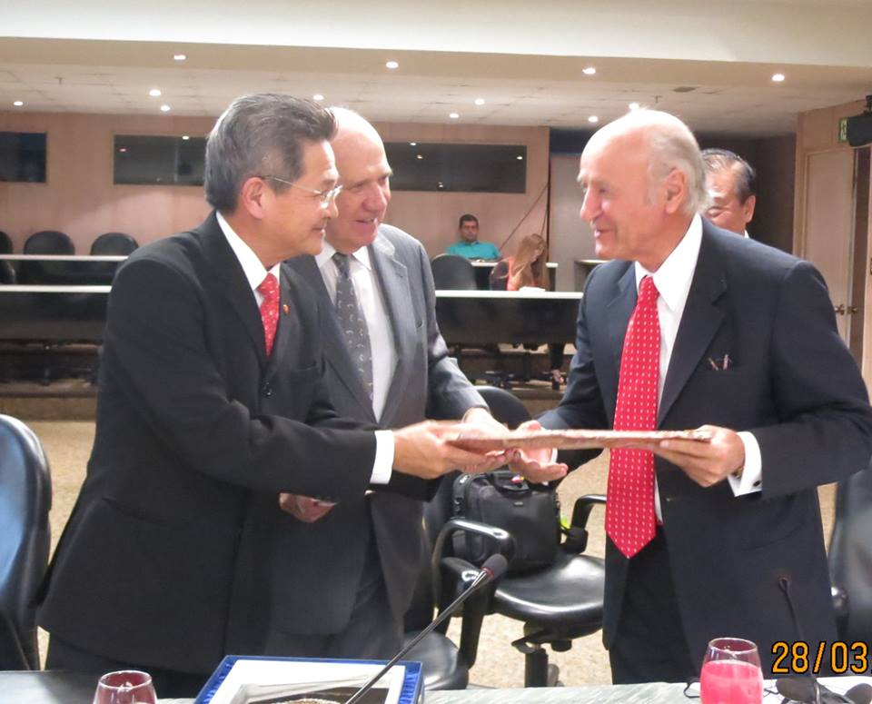
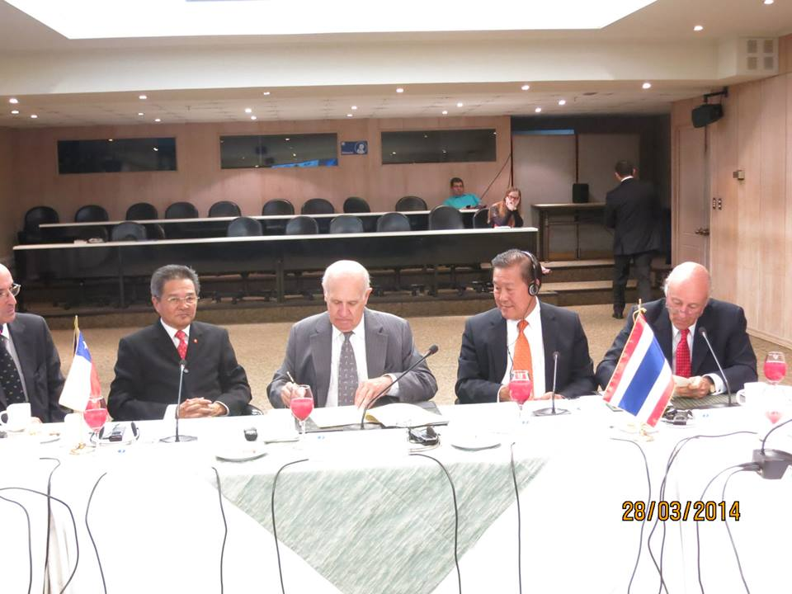
To promote the collaboration between the two countries, a Memorandum of Understanding was signed between SOFOFA and the Joint Standing Committee on Commerce, Industry and Banking (JSCCIB) to formally establish the Joint Business Councils (JBC) representing the co-operation between Thai-Chilean BC and Chilean-Thai BC . The signature was done on March 28th, 2014 at SOFOFA office in Santiago, Chile.
The MOU was signed by Mr. Carlos Hurtado Ruiz Tagle, Vice Chairman of SOFOFA and Mr. Arin Jira, Vice Chairman of the Federation of Thai Industries and was witnessed by Mr. Kanit Si, Chairman of Thai-Chilean Business Council and Mr. Juan Mackenna, Chairman of Chilean-Thai Business Council

Slide 17
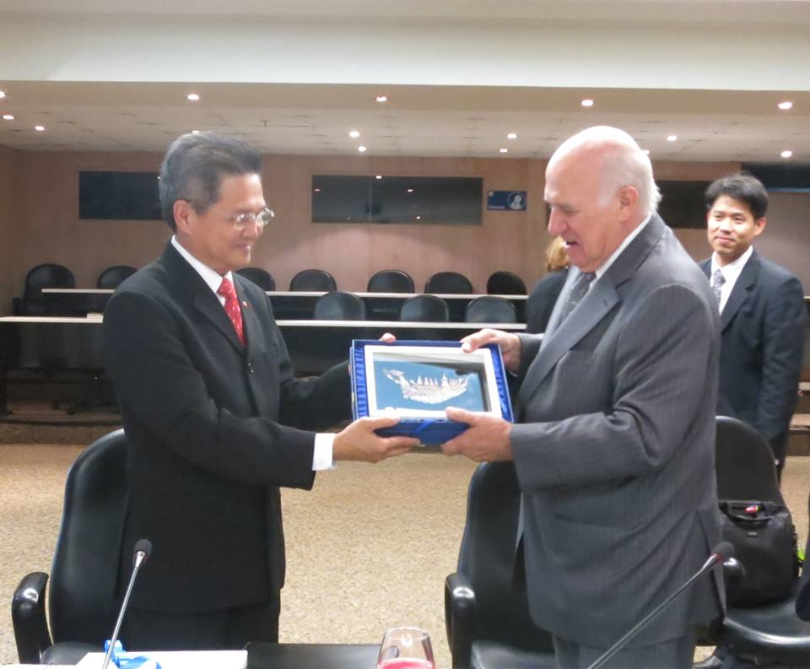
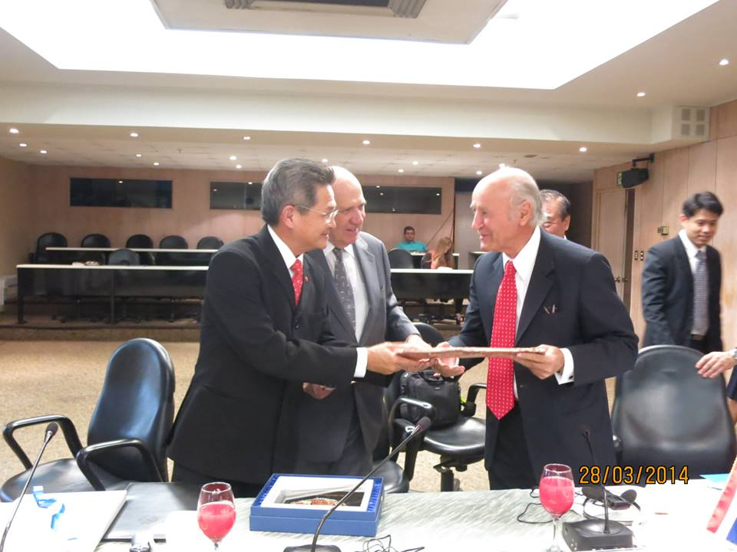
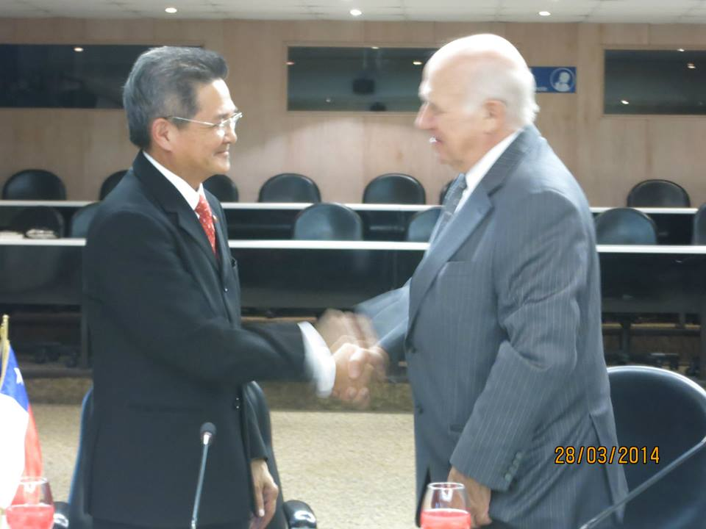
Objective Remark and introduction of JBC
to promote the closer relationship and joint efforts of trade, investment, technology, knowledge transfer, services and industries between Chile and Thailand for mutually beneficial partnership.
Exchange views on the FTA benefits between the Republic of Chile and the Kingdom of Thailand.
Discuss action plans and activities to be undertaken by JBC during 2014-2015
Invite Chilean Business organizations and companies to attend the FEALAC business forum to be held in Bangkok, Thailand during August 19-22, 2014. The forum is intended to provide business matching and knowledge of doing business in Chile and Thailand.
Set direction and guidance for business organizations in the two countries to relieve the far distance issue which prevented business expansion with each other in the past.

Slide 18
Agenda Item 2
- Minutes of 1st JBC meeting as attached -

Slide 19
Agenda Item 2
Recommendation:
……………………………………………………………………………………………………………………………………………………………………………………………………………………………………………………………………………………………...
Resolution:
………………………………………………………………………………………………………………………………………………………………………………………………………………………………………………………………………………………………

Slide 20
Agenda Item 3
Economic Overview of Chile and the Impact of Thailand-Chile FTA
Mr. Jaime Rivera
Trade Commissioner & Coordinator of ASEAN Markets

Slide 21
Agenda Item 3
Recommendation:
……………………………………………………………………………………………………………………………………………………………………………………………………………………………………………………………………………………………...
Resolution:
………………………………………………………………………………………………………………………………………………………………………………………………………………………………………………………………………………………………

Slide 22
Agenda Item 4
Briefing on ASEAN Economic Community (AEC)
Mr. Arin Jira
ASEAN Business Advisory Council, Chairman-Thailand and
Vice Chairman, The Federation of Thai Industries

Slide 23
ASEAN Charter
ASEAN
ASEAN Political Security Community (APSC)
ASEAN Economic Community (AEC)
ASEAN Socio-Cultural Community (ASCC)
One Vision, One Identity, One Community
Notes:
วัตถุประสงค์หลัก 3 ประการของการจัดตั้งประชาคมอาเซียน
ส่งเสริมการพัฒนาเศรษฐกิจ สังคม และวัฒนธรรมในภูมิภาค
รักษาเสถียรภาพทางเศรษฐกิจและความมั่นคงในภูมิภาค
ใช้เป็นเวทีแก้ไขปัญหาความขัดแย้งภายในภูมิภาค
ปี 2546 ผู้นำอาเซียน ลงนามในปฏิญญาบาหลี (Bali Concord II) แสดงเจตนารมณ์ การนำอาเซียนไปสู่ “ประชาคมอาเซียน” (ASEAN Community) ในปี 2020 (2563)
ปี 2550 ผู้นำอาเซียนลงนามในปฎิญญาเซบู เร่งรัดการเป็น “ประชาคมอาเซียน” ให้เร็วขึ้น เป็นปี 2015 (2558)
ปี 2550 รัฐมนตรีเศรษฐกิจอาเซียนลงนามรับรอง AEC Blueprint แผนงานการจัดตั้ง “ประชาคมเศรษฐกิจอาเซียน” (ASEAN Economic Community: AEC)
พฤศจิกายน 2550 ผู้นำอาเซียนลงนามใน “ASEAN Charter” และ “ปฏิญญาว่าด้วยแผนงานการจัดตั้งประชาคมเศรษฐกิจอาเซียน” เพื่อยืนยันเจตนารมณ์ร่วมกันดำเนิน การให้สำเร็จตามกำหนดในปี 2558

Slide 24
ASEAN Economic Community (AEC) Blueprint
Single Market and Production Base | Competitive Economic Region | Equitable Economic Development | Integration into the Global Economy
Free flow of goods Free flow of services Free flow of investment Freer flow of capital Free flow of skilled labor Priority Integration Sectors (12 sectors) | Competition Policy Consumer Protection Intellectual Property Rights (IPR) Infrastructure Development Taxation Laws E-Commerce | SME development Initiatives for ASEAN Integration (IAI) | Coherent approach towards external economic relations Enhanced participation in global supply networks

Slide 26
Country | Population (Million) (2014) | GDP per Capita Income (U.S. dollars) | GDP Growth (%)
 |  | 2014 | 2012 | 2013 | 2014 | 2015
Brunei Darussalam | 0.4 | 40,858.8 | 0.9 | -1.2 | 5.4 | 3.0
Cambodia | 16.0 | 1,087.8 | 7.3 | 7.0 | 7.2 | 7.3
Indonesia | 248.8 | 3,417.0 | 6.3 | 5.7 | 5.4 | 5.8
Lao P.D.R. | 6.7 | 1,567.0 | 7.9 | 8.2 | 7.5 | 7.8
Malaysia | 29.9 | 11,386.7 | 5.6 | 4.6 | 5.2 | 5.0
Myanmar | 61.7 | 910.4 | 7.3 | 7.5 | 7.8 | 7.8
The Philippines | 104.0 | 2,934.6 | 6.8 | 7.2 | 6.5 | 6.5
Singapore | 5.4 | 55,568.5 | 1.9 | 4.0 | 3.6 | 3.6
Thailand | 67.5 | 5,450.2 | 6.5 | 2.9 | 2.5 | 3.8
Vietnam | 93 .0 | 2,072.6 | 5.2 | 5.4 | 5.6 | 5.7
Source : International Monetary Fund, World Economic Outlook Database, April 2014

Slide 27
AEC Opportunities
Greater demand in goods and services bringing in expanded trade and investment opportunities
Availability of larger manufacturing bases
People development, increasing local employment, higher purchasing power, improved social stability
Enhancing opportunities for supporting industries
ASEAN-based foreign businesses are able to invest and receive available privileges as ASEAN companies
More incentives and larger opportunities for ASEAN investors to invest in neighboring countries

Slide 28
ASEAN’s Key Challenges
General unawareness of AEC 2015 and its benefits
Discrepancy over national and regional laws, rules, and regulations
Education skills, human resources development and effective job training to produce required skilled talents
Promotion of industrial development through R & D
Strong commitment from the ASEAN leaders
Coordination of competition to increase ASEAN bargaining power
Creation of effective measures to assist SMEs
Elimination of NTM’s

Slide 29
Conclusion
AEC creates greater opportunities for trade and investment
ASEAN must upgrade its industries and education skills
Business needs to utilize its full potential and core competence to capture AEC advantages
AEC increases Thailand’s role as a potential hub, so come and invest in Thailand and expand to other ASEAN member states

Slide 30
Agenda Item 5
Briefing & Discussion Session on Key Business Opportunities between Chile and Thailand
Mr. Phairush Burapachaisri
Vice Chairman, The Board of Trade of Thailand

Slide 31
The 2nd Meeting of
The Thai-Chilean/Chilean-Thai Joint Business Council
Key Business Opportunities between
Chile and Thailand
Mr.Phairush Burapachaisri
Vice-Chairman
The Board of Trade of Thailand

Slide 32
Key Business Opportunities between
Chile and Thailand
1.Food Industry
2.Energy
3.Mining
4.Tourism
5.Telecommunication
6.Automotive Industry
7.Education
8.Finance

Slide 33
1.Food Industry
Chile and Thailand have plenty of natural resources
Thailand is one of the world’s largest of food producers
Chile - ranks 17 amongst food exporting nations
- marine products to Thailand
Good opportunity for :
- Efficient methods of cultivation
- Providing food standard ,food safety and food security
- Food products with multi-features including ‘healthy,
‘flavor-intensive’, and ‘palate-pleasing’
- Food retail and food service sector (hotels, resorts, restaurants and institutional contracts)

Slide 34
2.Energy
Energy consumption is continually increasing both in Thailand and Chile
Many opportunities for Thai investors in new projects in Chile such as: SIC Trunk System Expansion Plan – New Infrastructure etc.
Chilean investors can also explore opportunities in the priority areas of the Thai Government such as: Biomass, Waste, Biogass, Wind power, Small Hydropower generation, Solar Power

Slide 35
3.Mining
Chile alone is responsible for producing one-third of all the copper in the world
Chile is also a major world supplier of molybdenum, gold, and silver
Opportunities for investment in mining development and expansion, and mining equipment

Slide 36
4.Tourism
Tourism is one of the biggest growth industries in Chile and Thailand
Tour agents should explore ways to bring Chilean tourists to Thailand and Thai tourists to Chile.

Slide 37
5.Telecommunication
The mobile telephony market is the fastest growing subsector in the telecommunication market
Thailand and Chile both have a large number of mobile users
A demand for investments in modernization of equipment and implementing new technologies will continue

Slide 38
6.Automotive Industry
Thailand is one of the world producers of
automotive,No.1 producer of one tons pick-up truck
Major export of OEM parts, Aftermarket (replacement) and accessory
Cooperation between Thailand-Chile for the region

Slide 39
7.Education / 8.Finance
There is a unique opportunity to meet the evolving and increasingly complex needs of universities and their students in both Chile and Thailand
Investments in education range from direct investments in institutions or schools, education services
Chile has a story profession of management in Financial services sector.

Slide 40
THANK YOU
GRACIAS

Slide 41
Agenda Item 5
Key Business Opportunities between Chile and Thailand
1. Food Industry
Chile and Thailand have plenty of natural resources. Food processing is one of the most dynamic sectors of the both economies. Thailand is one of the world’s largest of food producers such as rice, canned tuna, frozen seafood, chicken and canned pineapple. Meanwhile, Chile ranks 17 amongst food exporting nations. Thanks to the favorable agricultural-climatic qualities, the Chilean companies are in a position to offer high quality products of salmon, juice, canned fruit, wine and fish.
There is good opportunity for investment in efficient methods of cultivation like high density planting, micro agronomic techniques and organic farming.
An increased demand for convenient food and long-shelf life food products in Thailand. Thai consumers also favor imported food products from Chile such as wine.

Slide 42
Agenda Item 5
Key Business Opportunities between Chile and Thailand
1. Food Industry (Continue)
Opportunities for food products with multi-features including ‘healthy, ‘flavor-intensive’, and ‘palate-pleasing’ in both markets of Chile and Thailand
Opportunities in food retail and food service sector (hotels, resorts, restaurants and institutional contracts).
The flourish of packaged and processed food industry has opened a lucrative market segment for food machinery and packaging equipment in Thailand and Chile.

Slide 43
Agenda Item 5
2. Infrastructure
Infrastructure growth remains a top national priority for Thailand and Chile as both governments try to match the pace of infrastructures growth with economic growth. Both governments are encouraging foreign investments in infrastructure.
There are growth opportunities in key infrastructure sub-sectors: ports, railways, and roads. Particularly, there is a demand for investment in projects such as upgrading and building new highways; development of expressways and tollways; expansion of existing roads; development of metro projects; re-development of existing stations and railways.

Slide 44
Agenda Item 5
3. Mining
Roughly half of Chile’s revenues come from the sale of copper. In fact, Chile alone is responsible for producing one-third of all the copper in the world.
In addition to copper, Chile is also a major world supplier of molybdenum, gold, and silver. Chile is also a relevant supplier of non metallic minerals such as iodine, lithium, sodium and potassium nitrate.
There are opportunities for investment in mining development and expansion, and mining equipment.

Slide 45
Agenda Item 5
4. Tourism
Tourism is one of the biggest growth industries in Chile and Thailand. Tour agents should explore ways to bring Chilean tourists to Thailand and Thai tourists to Chile.
5. Telecommunication
The mobile telephony market is the fastest growing subsector in the telecommunication market. Thailand and Chile both have a large number of mobile users. Therefore, a demand for investments in modernization of equipment and implementing new technologies will continue.

Slide 46
Agenda Item 5
6. Healthcare and Wellbeing
Thailand is the medical hub of Asia and one of the world’s leading destinations for healthcare and wellbeing services. Demands for medical services are also growing in Chile along with the construction of new hospitals and healthcare centers under the Universal Access to Healthcare government program by the Chilean government. There are interesting opportunities for furniture (i.e. hospital beds), medical equipment and devices.
7. Education
There is a unique opportunity to meet the evolving and increasingly complex needs of universities and their students in both Chile and Thailand. Investments in education range from direct investments in institutions or schools, education services (e.g., administrative services, marketing, recruitment), education technology, educational content development.

Slide 47
Agenda Item 5
Recommendation:
……………………………………………………………………………………………………………………………………………………………………………………………………………………………………………………………………………………………...
Resolution:
………………………………………………………………………………………………………………………………………………………………………………………………………………………………………………………………………………………………

Slide 48
Agenda Item 6
Update on the FTA between CHILE and THAILAND
Mr. Pedro Reus
International Manager of SOFOFA

Slide 49
Agenda Item 6
Recommendation:
……………………………………………………………………………………………………………………………………………………………………………………………………………………………………………………………………………………………...
Resolution:
………………………………………………………………………………………………………………………………………………………………………………………………………………………………………………………………………………………………

Slide 50
Agenda Item 7
Discussion on Future Action Plan on
“ How to strengthen economic, trade and investment ties between Thailand and Chile”
Co-Chaired by
Mr. Kanit Si and Mr. Juan Mackenna

Slide 51
Agenda Item 7
Recommendation:
……………………………………………………………………………………………………………………………………………………………………………………………………………………………………………………………………………………………...
Resolution:
………………………………………………………………………………………………………………………………………………………………………………………………………………………………………………………………………………………………

Slide 52
Agenda Item 8
Update 2nd FEALAC Business Forum
Ms.Kanchana Thaichon
Director of JSCCIB - Thailand

Slide 53
Agenda Item 8
2nd FEALAC Business Forum
“Connecting the Two Engines of Global Growth”
August 19-20, 2014
@ Hotel Centara Grand and
Bangkok Convention Center at Central World,
Bangkok, Thailand

Slide 54
Agenda Item 8
Tentative Program
Tuesday, August 19, 2014
18.30-20.00 hrs. Welcome Reception
Hosted by JSCCIB-Thailand
Participants: All delegates, Speakers, and Guests
Venue: World Ballroom B, 23rd Floor

Slide 55
Agenda Item 8
Wednesday, August 20, 2014
08.30-17.00 hrs. 2nd FEALAC Business Forum
Venue: World Ballroom B, 23rd Floor
08.30 - 09.00 hrs. Registration
09.00-09.45 hrs. Opening Ceremony
Welcome Remarks
By Mr. Boontuck Wungcharoen,
Chairman of JSCCIB-Thailand (5 min.)
Opening Remarks
By H.E. Mr. Sihasak Phuangketkeow,
Permanent Secretary, Ministry of Foreign Affairs of the Kingdom of Thailand (10 min.)

Slide 56
Agenda Item 8
Keynote Address on “Enhancing the Economic Partnership between East Asia and Latin America”
By H.E. Dr. Surin Pitsuwan, Former ASEAN Secretary General (20 min.)
Guest Speaker on “Connecting the Two Engines of Global Growth: The Perspective of Latin America”
By Mr. Robson Braga de Andrade,
President, National Confederation of Industry of Brazil (10-15 min.)
09.45-10.00 hrs. Coffee Break

Slide 57
Agenda Item 8
10.00-1230 hrs.
Plenary Session I: “Prospects for Regional Cooperation between East Asia and Latin America: Presentation and Sharing Experiences”
Presentation:
Mr. Oswaldo Rosales, Director of International Trade and Integration, ECLAC (10 min.)
Mr.Yasushi Negishi, Country Director,
ADB ‘s Thailand Resident Mission (10 min.)
Panelists:
Representatives from Chambers of Commerce and Industry and Leading Business Organizations
Chairman, Mexican Business Council for Foreign Trade, Investment, and Technology (COMCE)
Mr. Juan Mackenna, Chairman of Chilean-Thai Business Council and representative of Chilean Federation of Industry (SOFOFA)

Slide 58
Agenda Item 8
Chairman, Indonesian Chamber of Commerce & Industry (KADIN)
Chairman, China Council for the Promotion of International Trade (CCPIT)
Mr. Cho Young Jun, Representative of KCCI in Vietnam,
Korea Chamber of Commerce and Industry
Mr. Phairush Burapachaisri, Vice Chairman, The Board of Trade of Thailand
Mr. Arin Jira, Vice Chairman, The Federation of Thai Industries
Q & A (including discussion on how to institutionalize FEALAC Business Forum)
Moderator: Dr. Francis Chua, Chairman Emeritus,
The Philippine Chamber of Commerce and Industry (PCCI)

Slide 59
Agenda Item 8
12.30-14.00 hrs,. Luncheon
Honorary Guest Speaker: Dr. Narongchai Akarasenee,
Chairman, the Board of Directors, MFC Asset Management Plc.
Venue: Ginger, 24th Floor
14.00-16.00 hrs. B2B Networking
Food & Agro-Industry, Hospitality, Wellness and Healthcare service industry, Energy
Venue: World Ballroom B, 23rd Floor

Slide 60
Agenda Item 8
Recommendation:
……………………………………………………………………………………………………………………………………………………………………………………………………………………………………………………………………………………………...
Resolution:
………………………………………………………………………………………………………………………………………………………………………………………………………………………………………………………………………………………………

Slide 61
Closing Remarks

